Slide 1
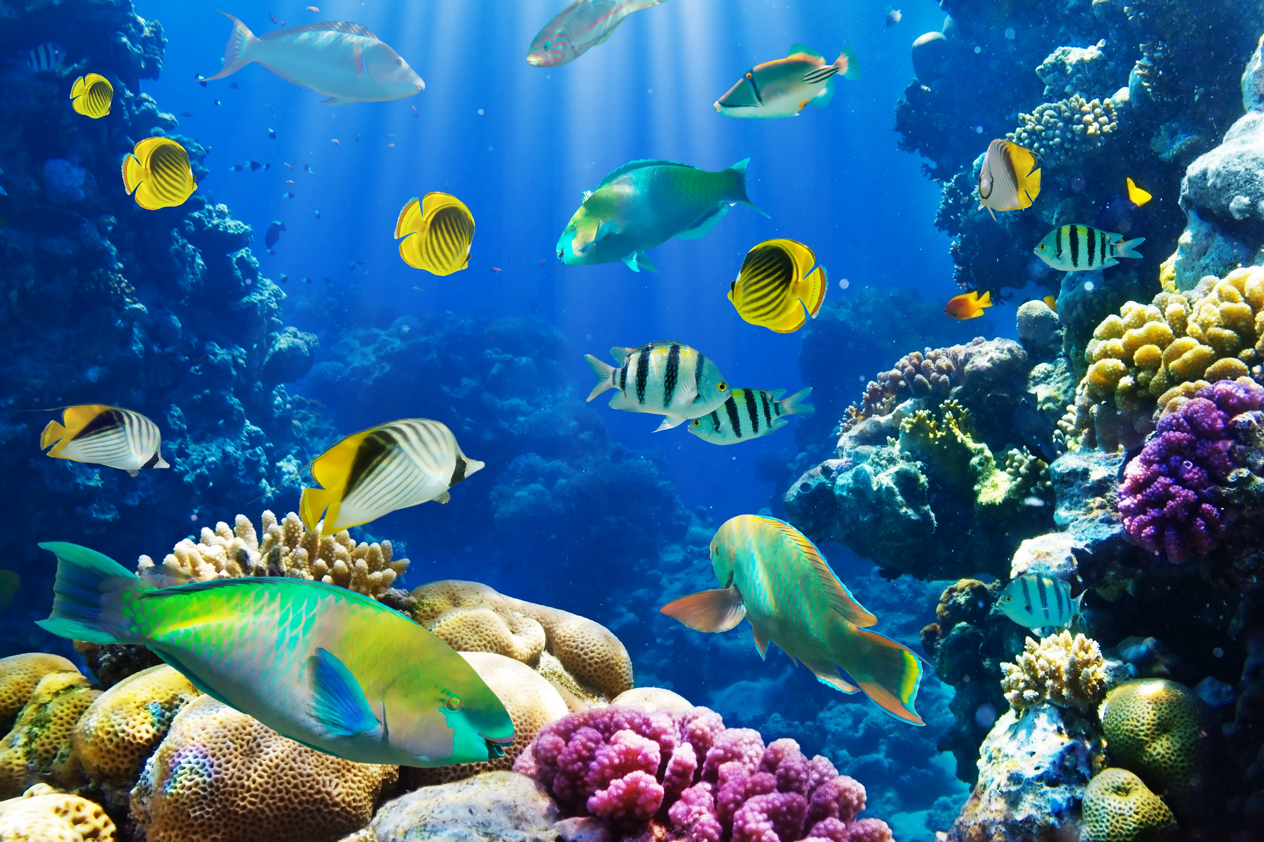
Workshop: Something’s Fishy…
Professor Sidebotham
The Cooper Union for the Advancement of Science and Art

Slide 2
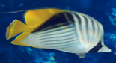

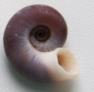

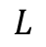
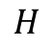
PROBLEM STATEMENT:
I just bought an aquarium, and I want to get some pet fish. But first, I have to get their water temperature right, a fixed input. I bought a glass 10 gallon (nominal) tank, and a simple immersion heater. There’s no thermostat (a feedback/control system), but the power to the heater can be set to a constant value (up to a maximum possible power input). I wasn’t smart enough to start with hot tap water, so I turned the heater on with cold water.
How long do I have to wait after turning on the heater full blast until I can put my 2 fancy tropical fish and a snail in (I think I’ll name them Mr. Moop, Goldie and The Ram, and write a song about them. Well, I already did that…).
Once there, what power level should I set???
A Heat Transfer Model for this problem is developed in the following slides. An excel template has been provided, making for a “closed-ended” problem. For the Workshop, you can choose to either:
Review this model, complete the template.
Review this model, write a Python script or Jupyter notebook to solve
Create your own model (DON”T LOOK AT NEXT SLIDES) and implementation.
Include a plot of Temperature vs time (going a bit past once the set point is reached), and the rates of heat transfer through all thermal channels.
$$H$$
Mr. Moop
Goldie
The Ram
$$W$$
$$L$$

Slide 3
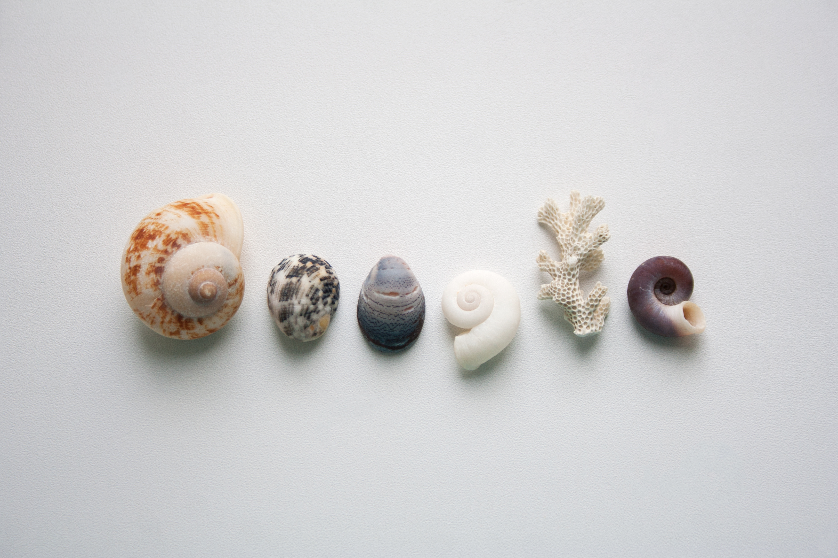

Slide 4
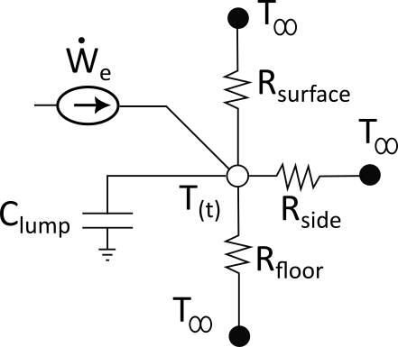
A (not “The”) Heat Transfer Model:
Lump the capacitance of the glass and the water
Consider 3 thermal channels (each with a different input value of U): at the free surface, the side walls and through the floor.
The heater acts as a current source.
Ambient temperature is constant.
Tank is filled to the brim (no “rim” effect).
Empty weight is dominated by glass of uniform thickness
Sidebar:
What’s the difference between “A” and “The” in technical writing?
Use “A” the 1st time a thing is introduced. Use “the” thereafter.
Example: A heating element with a thermostat is used to add thermal energy. The thermostat turns on the heating element when needed. In this problem, a human acts as the thermostat.

Slide 5
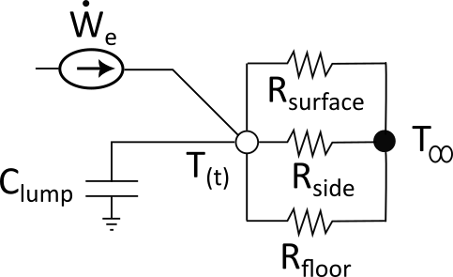
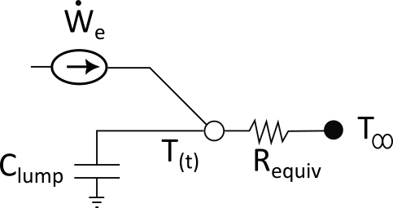
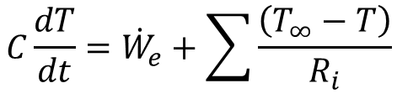
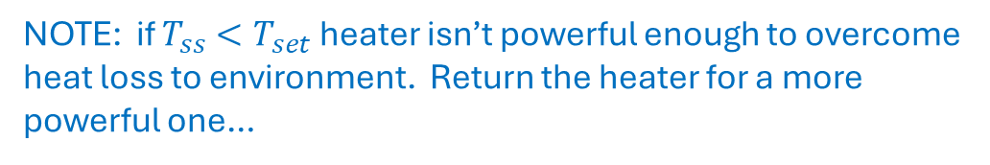
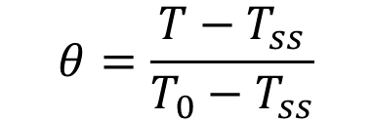

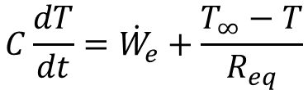
$$C\frac{dT}{dt}={\dot{W}}_{e}+\sum{\frac{\left(T_{∞}−T\right)}{R_{i}}}$$
$$C\frac{dT}{dt}={\dot{W}}_{e}+\frac{T_{∞}−T}{R_{eq}}$$
You could integrate this 1st order ODE, but there’s an elegant “fancy” way to create a dimensionless temperature that starts at 1 and ends at 0 (if you let it go to equilibrium. We’ll stop it before then, but for analyzing, that’s OK).
Solve for the STEADY STATE temperature (T_{ss}) by setting time derivative to zero.
$$T_{ss}=T_{∞}+R_{eq}{\dot{W}}_{e}$$
NOTE: if $T_{ss}<T_{set}$ heater isn’t powerful enough to overcome heat loss to environment. Return the heater for a more powerful one…
$$θ=\frac{T−T_{ss}}{T_{0}−T_{ss}}$$

Slide 6
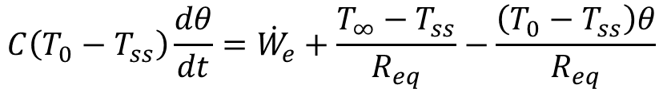
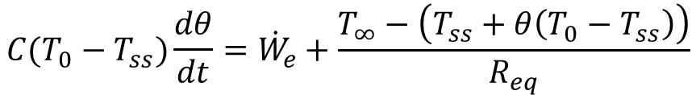
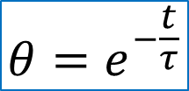
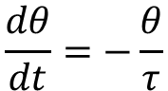
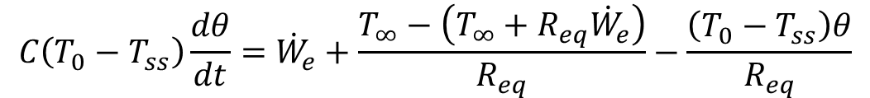
$$C(T_{0}−T_{ss})\frac{dθ}{dt}={\dot{W}}_{e}+\frac{T_{∞}−\left(T_{ss}+θ\left(T_{0}−T_{ss}\right)\right)}{R_{eq}}$$
$$C\left(T_{0}−T_{ss}\right)\frac{dθ}{dt}={\dot{W}}_{e}+\frac{T_{∞}−T_{ss}}{R_{eq}}−\frac{\left(T_{0}−T_{ss}\right)θ}{R_{eq}}$$
$$C\left(T_{0}−T_{ss}\right)\frac{dθ}{dt}={\dot{W}}_{e}+\frac{T_{∞}−\left(T_{∞}+R_{eq}{\dot{W}}_{e}\right)}{R_{eq}}−\frac{\left(T_{0}−T_{ss}\right)θ}{R_{eq}}$$
$$\frac{dθ}{dt}=−\frac{θ}{τ}$$
$$θ=e^{−\frac{t}{τ}}$$

Slide 7
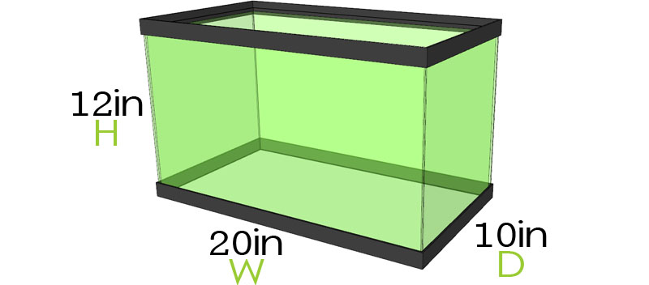
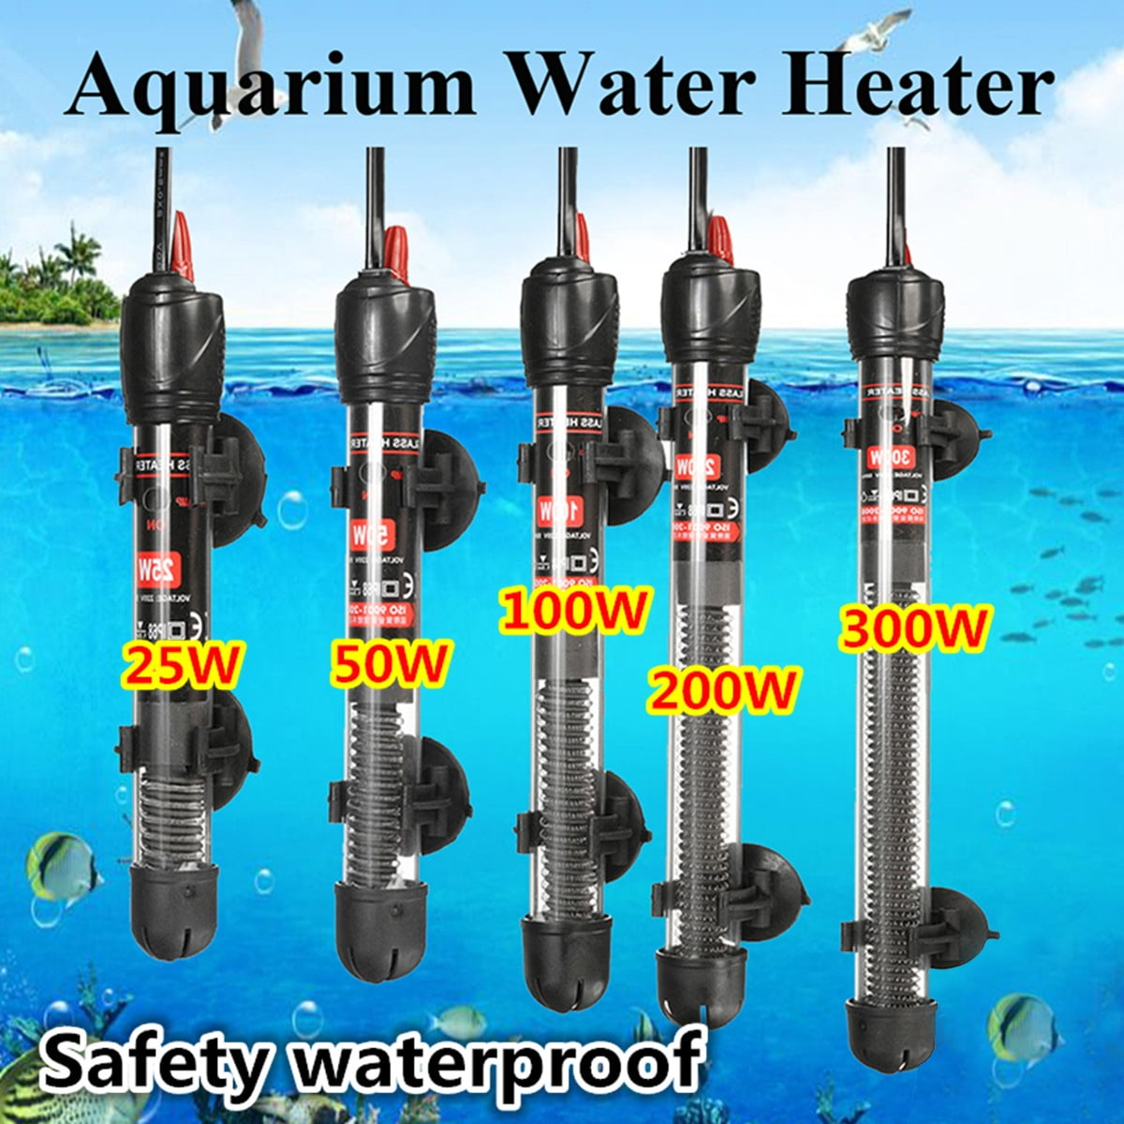
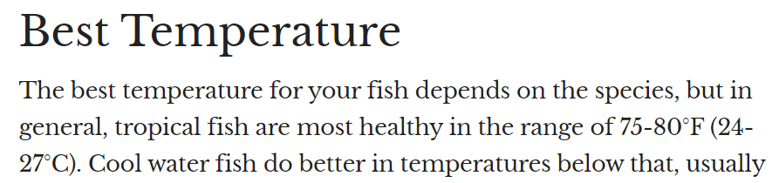
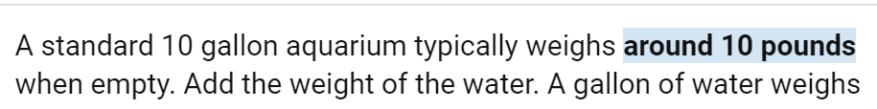
APPENDIX: Spec Data

